Slide 1
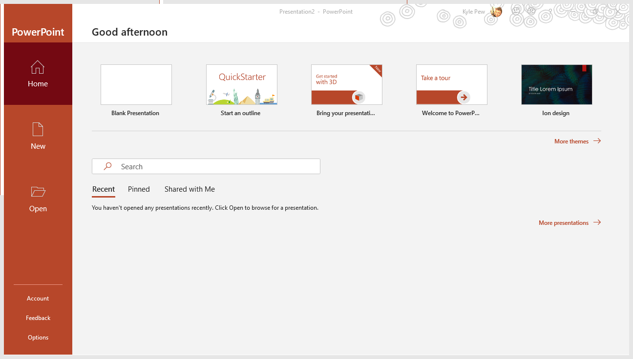
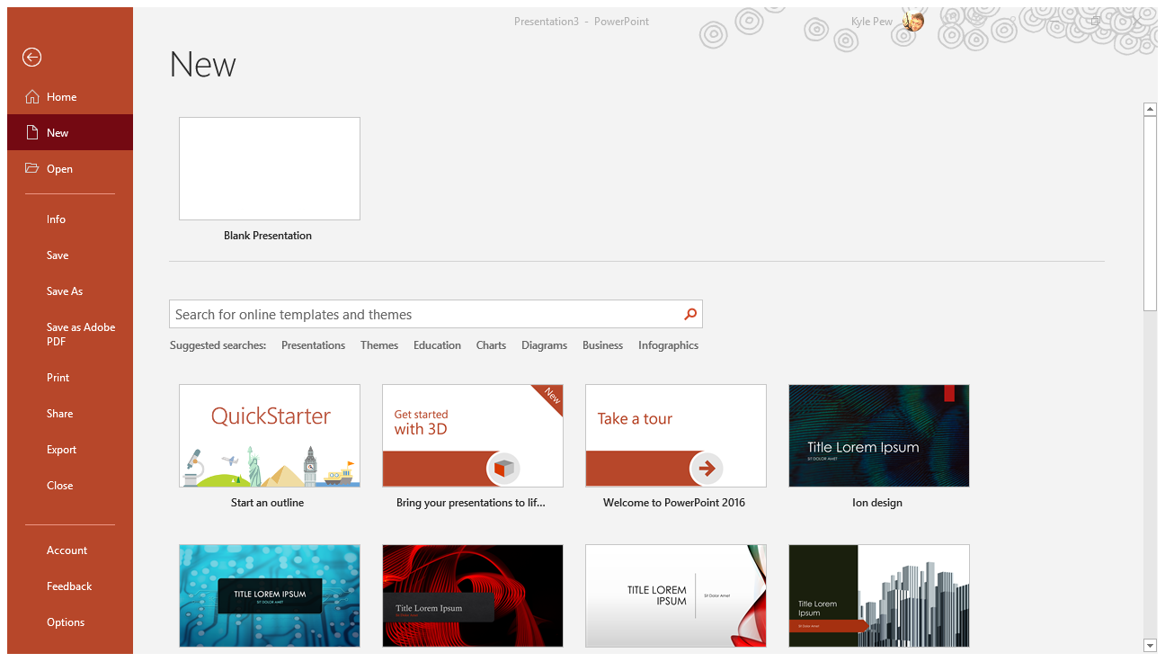
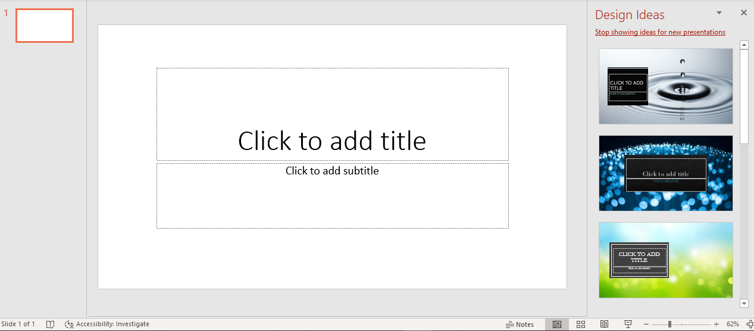
Microsoft PowerPoint 101
Identify Foundational Microsoft PowerPoint Commands and Functions

Slide 2
PowerPoint Startup Screen
First Screen when opening PowerPoint
Find Recent Files
Create New PowerPoint Files
Browse/Open Files
Office 365 Account Options
PowerPoint Options

Slide 3

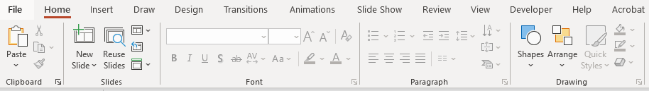
PowerPoint Ribbon & QAT
PowerPoint Ribbon
Find all the PowerPoint Features and Functions
MAC Users won’t have a FILE tab, but will have a FILE menu (TOP LEFT)
Tabs will change based on what tools or element you have selected
PowerPoint Quick Access Toolbar (QAT)
Provides Quick Easy Access to your favorite and commonly used tools
Right Click a command on the Ribbon to add it to the Quick Access Toolbar

Slide 4
PowerPoint Presentation Interface
The bulk of the PowerPoint interface is dedicated to editing your slides/presentation
Microsoft provides Design Ideas to inspire your choices
Bottom Right offers alternate view for editing

Slide 5
Creating a New Presentation
FILE tab – NEW
From the NEW window you can select BLANK PRESENTATION or select from one of many PowerPoint THEMES/TEMPLATES
CONTROL + N will create a new PowerPoint Presentation File
Standard PowerPoint files have an extension of .PPTX

Slide 6
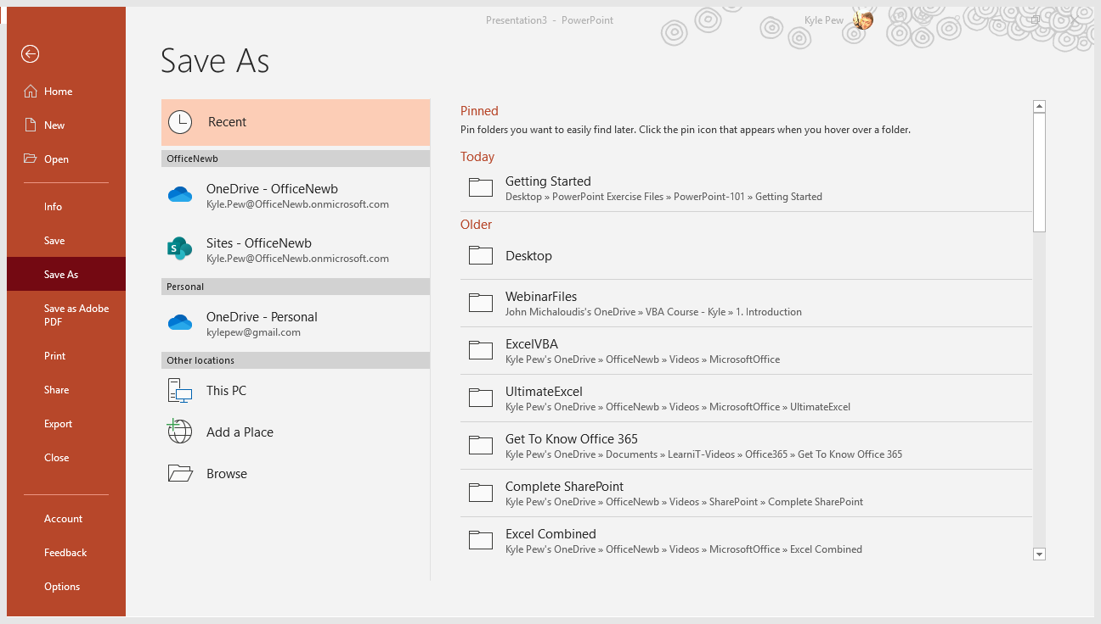
Saving a Presentation
FILE tab – SAVE
Save a file to update the previously saved file
FILE tab – SAVE AS
Update File Name and or save location
FILE tab – SAVE AS PDF
CTRL + S --- SAVE
CTRL + SHIFT + S --- SAVE AS

Slide 7
Microsoft PowerPoint 101
Identify Foundational Microsoft PowerPoint Commands and Functions

